Slide 1
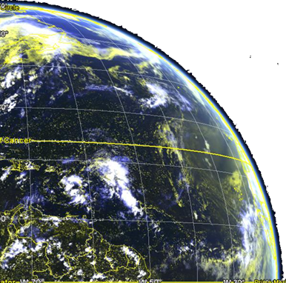
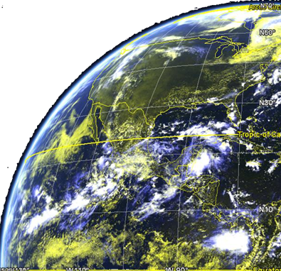
NOAA Cloud Product Status
Andrew Heidinger, NOAA/NESDIS
Mike Foster, Andi Walther and Steve Wanzong, UW/CIMSS

Slide 2
NOAA Satellite Status
NOAA is undergoing a major change in both its satellites and how it processes data
Geostationary
GOES-R Advanced Baseline Imager (ABI) will launch in October, 2016.
GOES-R is same instrument as JMA’s AHI but which a 1.38 µm in place of the the 0.55 µm channel (no direct true color from ABI).
NOAA plans to make 15 minutes full-disk, 5 minute CONUS and 1 minute data from two mesoscale regions.
Polar Orbiting
The first Joint Polar Satellite System (JPSS) launches in early 2017.
Instrument complement is the same as Suomi NPP.
SNPP and JPSS-1 will be separated by 20 minutes and fly in formation like EUMETSAT does for METOP-A and METOP-B.

Slide 3
NOAA Cloud Processing Status
Geostationary
NOAA developed GOES-R algorithms in 2010 and delivered to a private contractor who implemented them into a new ground system.
These “Baseline” algorithms will be the official product data for the first year(s).
NOAA continued to evolve algorithms and have developed an “Enterprise” set of algorithms. Enterprise means these algorithms support multiple satellites and instruments.
NOAA plans to replace the Baseline with the Enterprise when possible.
Polar Orbiting
Private industry developed algorithms and ground system that still are the official products.
NOAA Enterprise algorithms slated to become operational this year.
Enterprise and private industry algorithms will run in parallel until 2019.
Direct Broadcast
CIMSS leads the development of the Community Satellite Processing Package (CSPP).
CSPP supports leo and geo data and allows access to NOAA Enterprise algorithms via direct processing of local DB data.

Slide 4
http://www.goes-r.gov
Notes:
The subjects of this GOES-R Baseline products training are the aerosol products boxed in yellow.

Slide 5
Other Cloud Applications
Beyond the Baseline, NOAA has funded other cloud products and related applications.
Aviation Applications: Fog detection, icing, cloudiness at flight levels
Convection Applications: Convective Initiation and Severe Weather Identification and Prediction.
Solar Energy Forecasts: Cloud properties are being used for making short term forecasts (sub hourly) .
Precipitation: Use of the cloud-derived precipitation (taken from KNMI) in the official suite of NOAA precipitation products.
Operational transition of some of the products is unknown but many have established user bases via routine processing outside of NOAA operations.

Slide 6
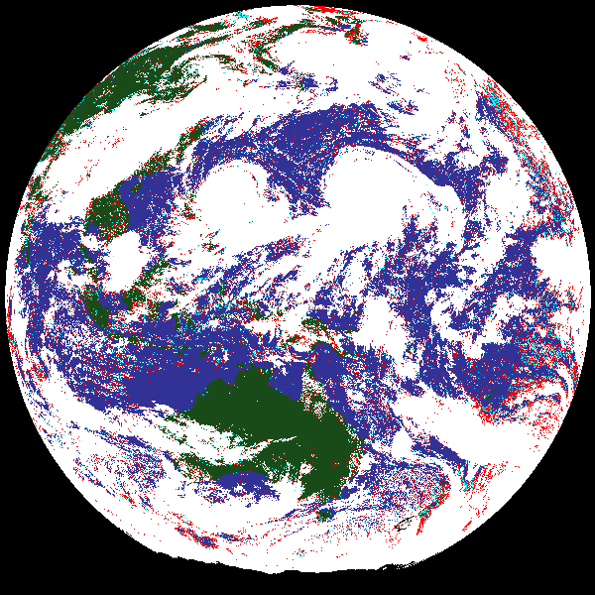
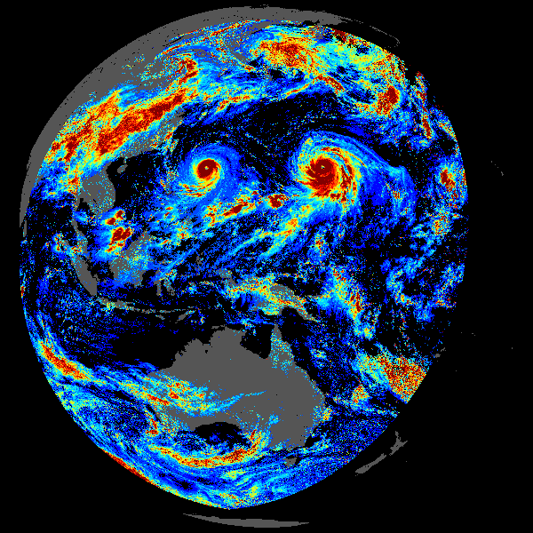
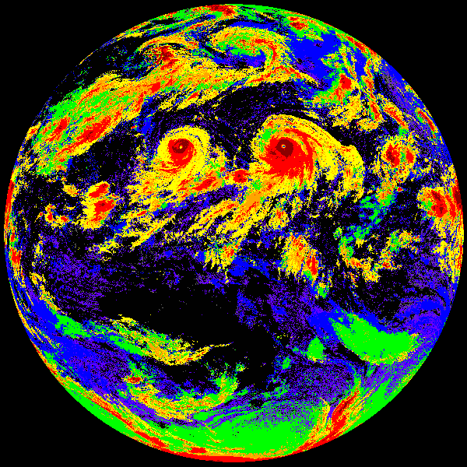
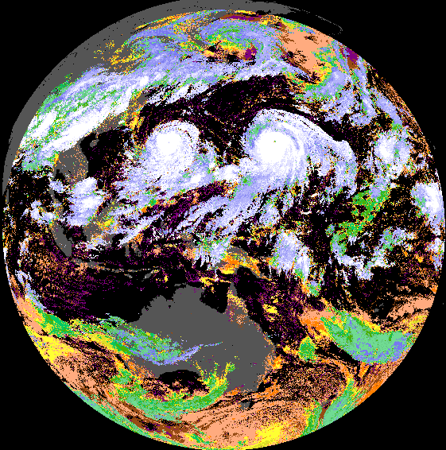
NOAA Cloud Algorithm Summary
Mask: 4 -level
Probabilistic (naïve Bayesian)
Day Optical & Micro:
Optimal Estimation with analytic LUTS. Modes support 1.6, 2.2, 3.75 μm: τ, r_{eff}, LWP, IWP, solar trans, albedo. Now supports lunar ref (VIIRS DNB)
Type:
Multi-spectral IR with minimal VIS/NIR. 7 types
Height: IR-only Optimal Estimation with analytic RTM and multilayer treatment.
Output; ε, β, Tc, Zc, Pc, Zbase, Zalt, Zlower, τ, r_{eff}
Night Optical & Micro: NASA SatCORPS (Minnis) version for GOES-R

Slide 7
Algorithm Improvements Since Last CREW
New Lapse rate parameterization into cloud height. This topic to still be an issue looking the AHI intercomparisons.
Added more microphysical model options to our cloud height and seeing improvements when using our “Empircal” model (Heidinger, et al. 2015)
Added VIIRS DNB to NOAA VIIRS Cloud Mask
Added dust, smoke and shadow tests in cloud mask.
Added several spatial processing steps to improve cloud edge performance in cloud height.
We now derive the lower cloud layer in multi-layer situations.
We are still heavily developing a merged sounder and imager algorithms for HIRS/AVHRR and VIIRS/CrIS. (see talk given at EUMETSAT Mtg.)

Slide 8
IR Microphysics
One Day MODIS (8.5,11,12 μm)
Global Results
Without absorption channels, cloud height retrievals are very sensitive to assumed microphysical model.
We run our height retrievals with different IR models from Ping Yang’s Library.
We developed an “Empirical” model based on maximizing spectral consistency between 8 – 12 μm. (Heidinger et al. 2015)
Has a significant improvement (1 – 2 km) for this scene but selection of one optimal model for global applications remains problematic.
Empirical Model
C6 agg col
VIIRS Example (8.5, 11, 12 μm) co-located with CALIPSO/CALIOP
PATMOS-x with MODIS C6 Model (agg columns)
PATMOS-x with an “Empirical Model”
tropopause
Height
Height
CALIOP Cloud Layers
VIIRS retrievals
surface
Latitude

Slide 9
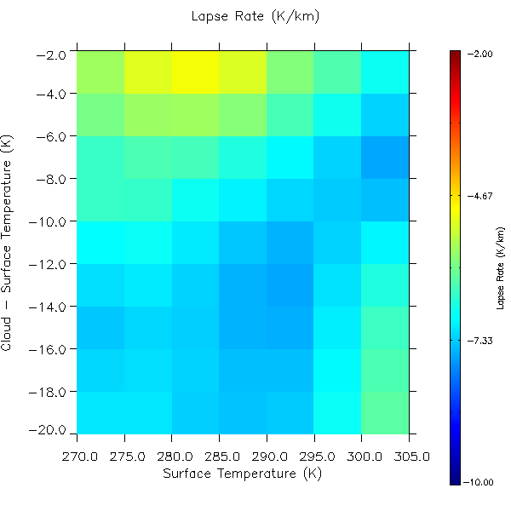
Improved Lapse Rate Formulation
As is well-known, NWP often miss low level inversions and using assumed lapse rates results in better heights for low clouds.
The NOAA Cloud Height always used an oceanic lapse rate parameterization based on the Cloud – Surface Temperature which comes from CALIPSO data and an SST analysis.
We have found basing it on both the Cloud – Surface Temperature and Surface works better.
NASA Langley and NASA GSFC have alternative parameterizations.
I think this remains a big issue in our inter-comparisons.

Slide 10
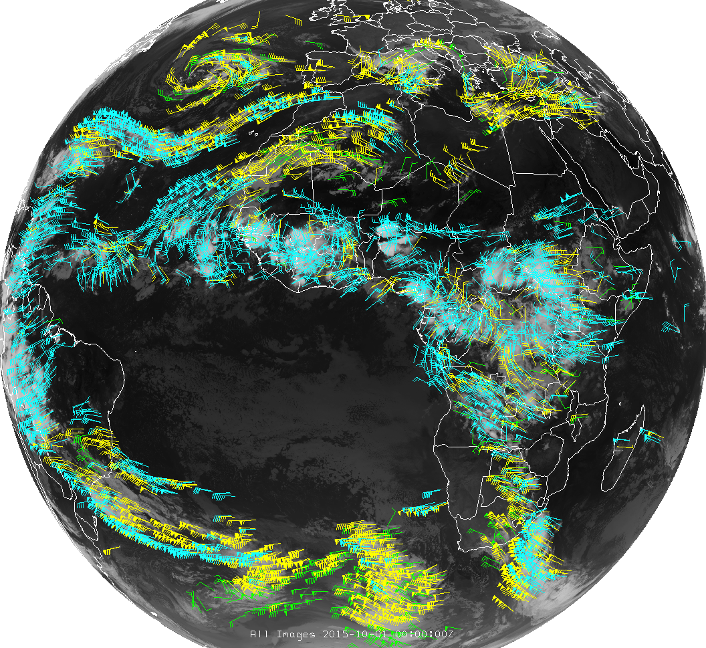
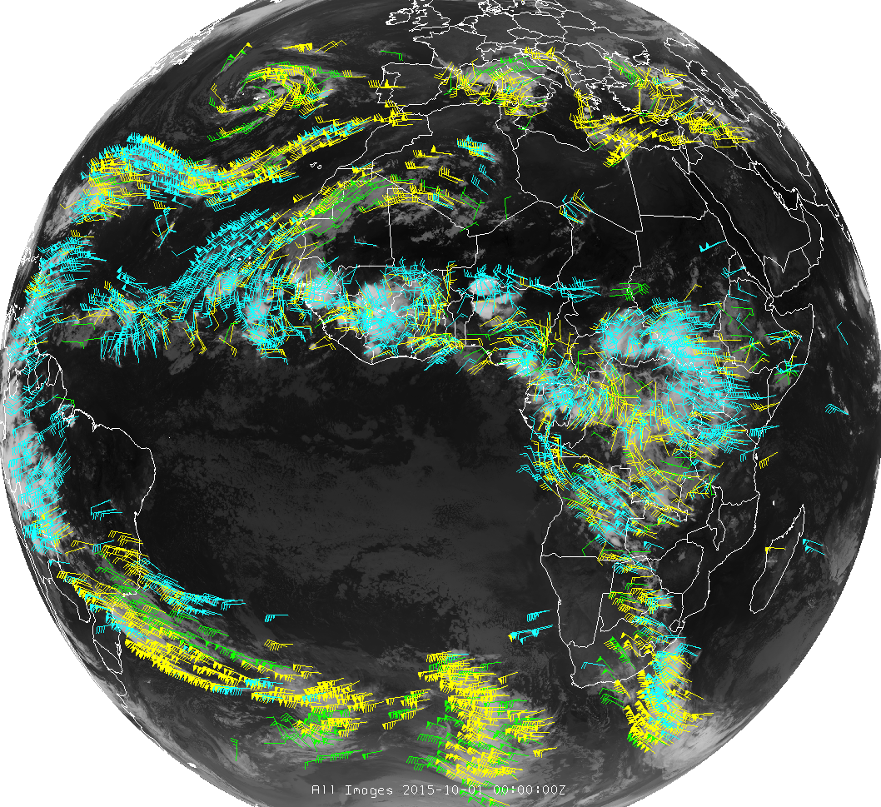
IWWG Collaboration
Atmospheric Motion Vectors (aka Winds) rely more and more on cloud heights to assign their heights.
Wind are generated from trackable targets and are often cloud edges.
The ICWG is exploring specific validation focus on the heights used in Wind retrievals and exploring developing diagnostics to aid in their usage.
Steve Wanzong will report on this at the IWWG next month.
OCA = Optimal Cloud Analysis (EUMETSAT)
ACHA = AWG Cloud Height Algorithm (NOAA)
OCA and ACHA heights run through the GOES-R winds algorithm
ACHA
OCA
100 – 250 hPa
251 – 350 hPa
351 – 500 hPa

Slide 11
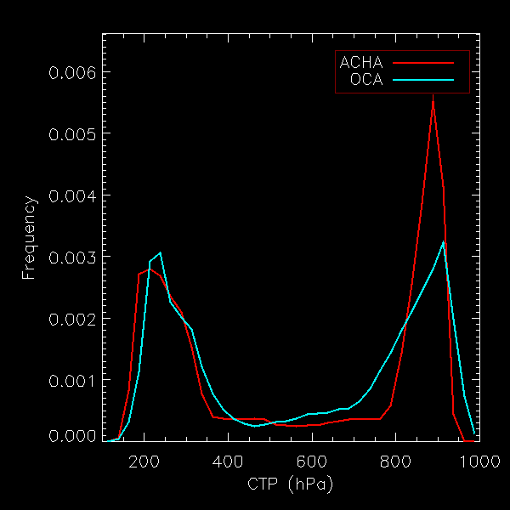
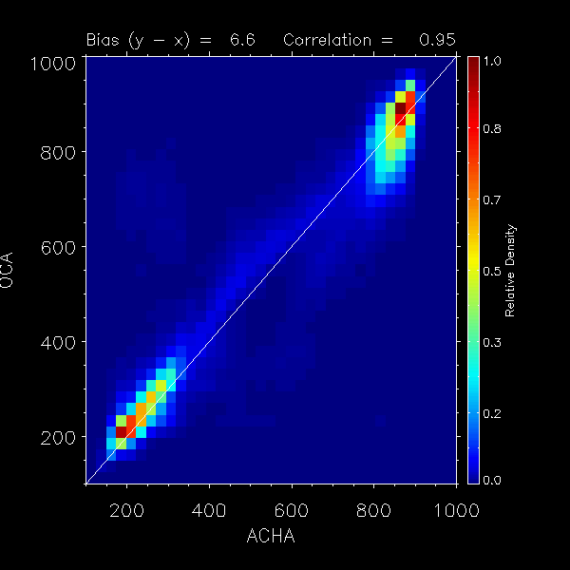
Comparison of Heights Used for Winds
Steve Wanzong modified CLAVR-x to read OCA Level-2 files from SEVIRI and to ingest OCA and ACHA into CLAVR-x Level-2 output.
GOES-R Winds algorithm applied to these heights.
Height comparison below is only for the final heights of the wind vectors after the filtering and data rejection of the GOES-R Winds Logic.
These are the 10.8 μm Wind Vectors. Complete analysis shown at IWWG.
October 12, 2015 – All time periods
OCA = Eumetsat Height, ACHA = NOAA Height

Slide 12
IWWG / ICWG Collaboration Ideas
IWWG activities
The IWWG has developed a standard Quality Index (QI) which is provided in all Winds Product files.
The IWWG also spends much time in standardizing the contents of the BUFR files given to NWP Centers.
Following their lead ..
Many cloud products are being reported in the BUFR files that go NWP (e.g. for CrIS data assimilation). Can we agree on a standard set that all agencies can provide?
Can the ICWG develop standard quality metrics for some of our products (like cloud height) that feed into these BUFR files? (maybe O.E. and cloud mask breakouts can discuss this)

Slide 13
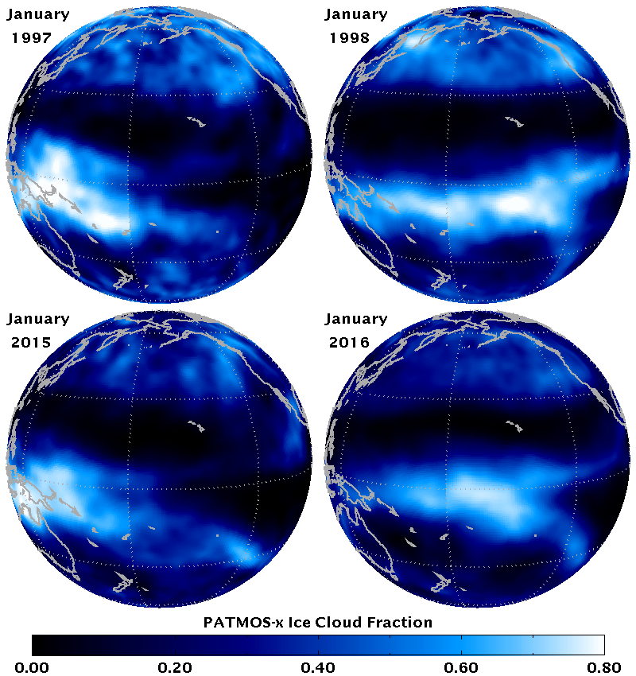
PATMOS-x Status
The Pathfinder Atmospheres Extended remains our main climate data offering.
The AVHRR version (1980 – 2015) is an operational CDR at the NOAA National Center for Environmental Information (NCEI).
Our Level-2b data (0.1 degree) updated daily. Starting in 2016, Level-2 data is also delivered.
We also have large amount of the GOES 8-15 record processed through PATMOS-x. Available through the CIMSS Climate Data Portal.
We have one year of SNPP VIIRS data generated through PATMOS-x
AVHRR/HIRS version will be ready later this year.
What is the ICWG role in real-time climate products?
Ice Cloud Patterns before and during El Nino (BAMS SoC)
AVHRR
VIIRS

Slide 14
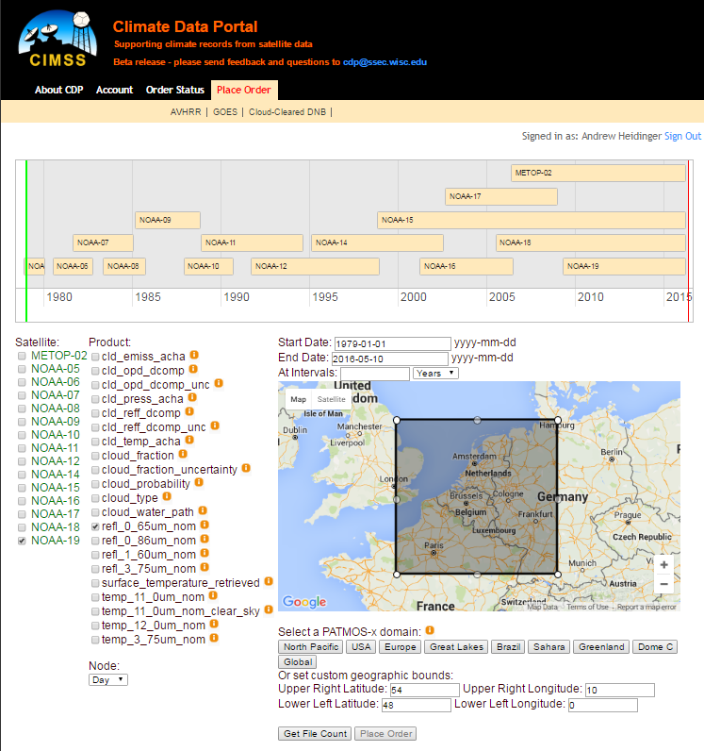
CIMSS Climate Data Portal
As a complement to the NCEI interface, CIMSS developed a Climate Data Portal (Tommy Jasmin)
Allows for parameter, temporal, spatial and sensor sub-setting.
AVHRR and GOES are there, MODIS coming.
Goal is to expand to other CIMSS climate data.
291 data orders in last year.
http://cimss.ssec.wisc.edu/cdp

Slide 15
Conclusions
NOAA is undergoing a major update of its Satellites and developed a more integrated line of satellite products made in partnership with industrial contractors.
The NOAA cloud products and applications are continuing to advance and these will be available in parallel from NESDIS/NESDIS and from the CSPP packages.
Research using sounder and imagers is leading to improvements in our real-time and historical processing of the polar orbiting imagers.
There is an active collaboration with the IWWG on the use of cloud heights in wind vector retrievals. The ICWG might explore the standardization of our products and quality metrics for this application.

Slide 16
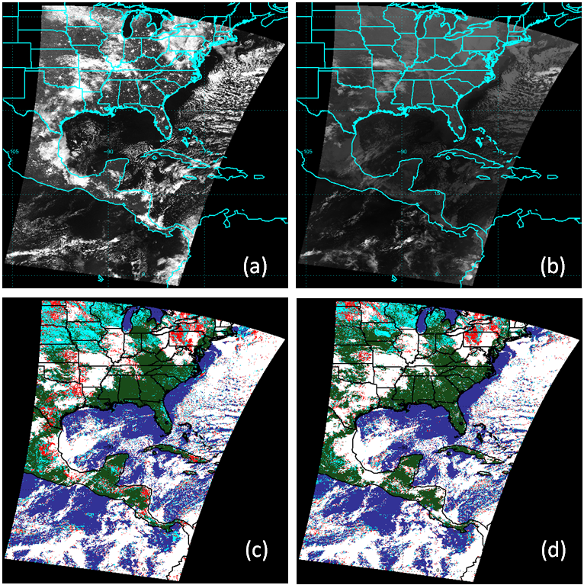
Impact of Lunar Reflectance on Cloud Mask Detection
Less uncertainty to cloud mask when DNB is used
Original probably cloudy scenes are identified as confidently cloudy
Global Nighttime Stats:
POD values increase from 90% to 93%. (relative to CALIPSO)
cloud fraction increases by 3%
Probably cloudy amount drops in half.
Lunar Ref (%)
11 μm BT
Without DNB
With DNB

Slide 17
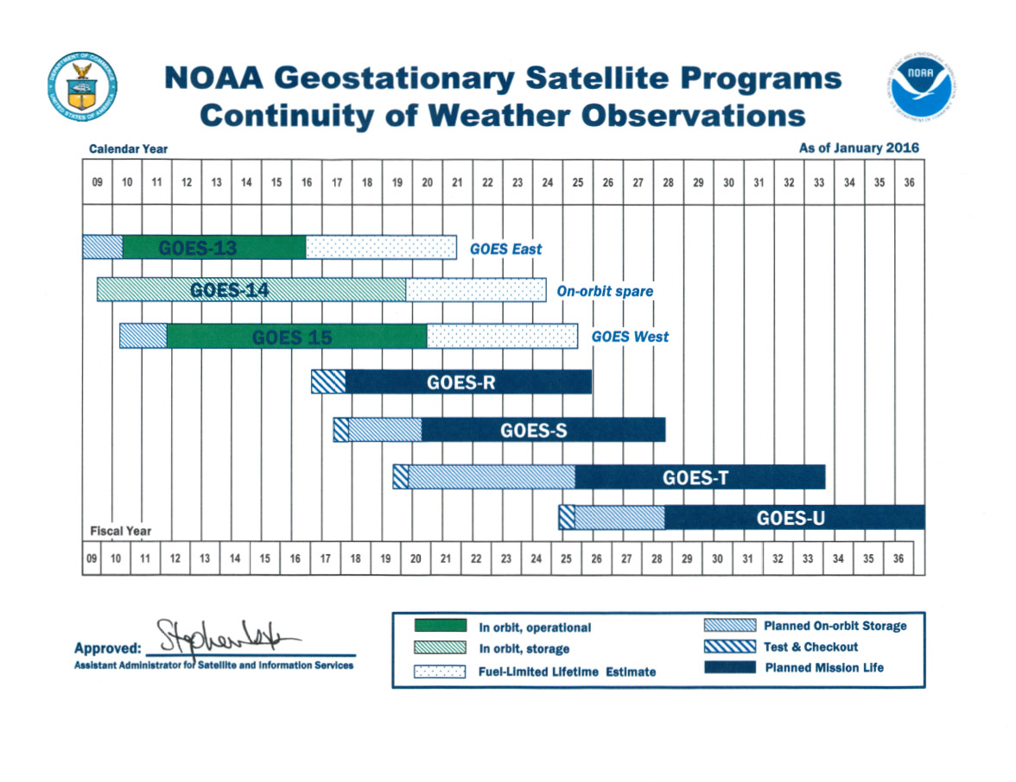
NOAA Geo Fly-out Chart

Slide 18
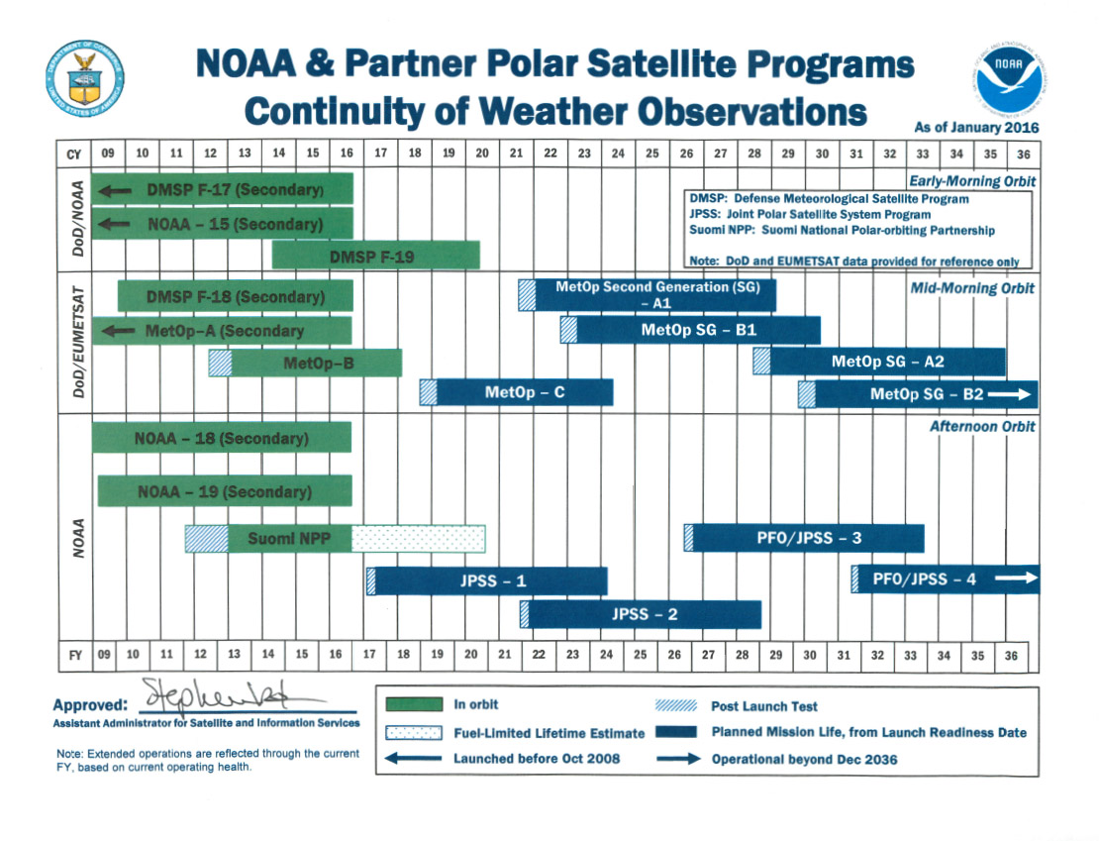
NOAA Polar Fly-out Chart

